Slide 1
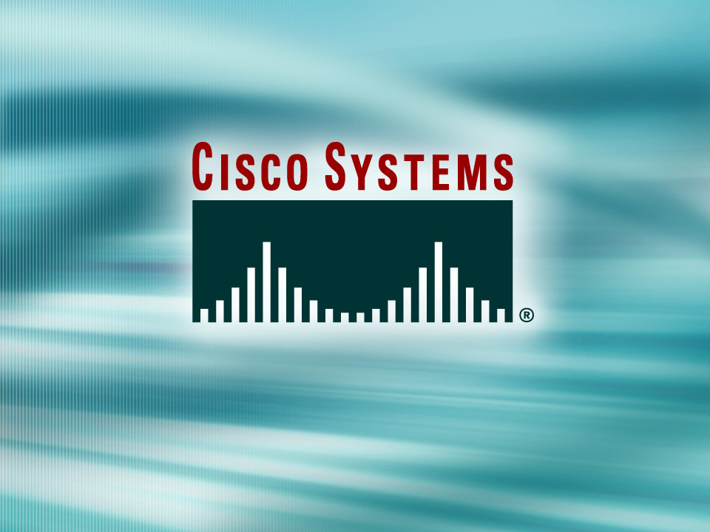
© 2002, Cisco Systems, Inc. All rights reserved.

Slide 2

Router Startup and Configuration Management
© 2002, Cisco Systems, Inc. All rights reserved.
Notes:
Purpose: This chapter introduces the Cisco IOS™ CLI on the Catalyst® 1900 switch and router.
Timing: This chapter should take about 2 hours to present.
Note: The Catalyst 1900 switch only has a subset of the router Cisco IOS commands available.
Contents:
Introduction to Cisco IOS. Explain to the student what is IOS?
Cisco Device startup procedures in general.
IOS configuration source.
General introduction to the IOS CLI.
Cat 1900 switch startup procedures.
Intro to Cat 1900 CLI. This part covers the basic configuration on the switch, like setting the IP address and hostname. More details about the various Cat 1900 switch configuration commands are explained in Chapter 6 and 7.
Router startup procedures. More details on the router startup process is discussed in chapter 5.
Router IOS CLI.

Slide 3
Objectives
Upon completing this lesson, you will be able to:
  Describe the router boot sequence and explain how to verify that the router booted correctly
  Identify the internal components of Cisco switches and routers
Notes:
Slide 1 of 2
Purpose: This slide states the chapter objectives.
Emphasize: Read or state each objective so that each student has a clear understanding of the chapter objectives.
Note: Catalyst switches have different CLIs. The Catalyst 2900xl and the Catalyst 1900 has a Cisco IOS CLI. The Cisco IOS CLI commands available on the 2900xl is different from the 1900. The Catalyst 5000 family has no Cisco IOS CLI, and use the set commands instead. This class only covers the configuration on the Catalyst 1900 switch.

Slide 4
Router Power-On/Bootup Sequence
Perform power-on self test (POST).
Load and run bootstrap code.
Find the Cisco IOS software.
Load the Cisco IOS software.
Find the configuration.
Load the configuration.
Run the configured Cisco IOS software.
Notes:
Emphasize: In a later slide, there is a very detailed flowchart of the router startup process.

Slide 5
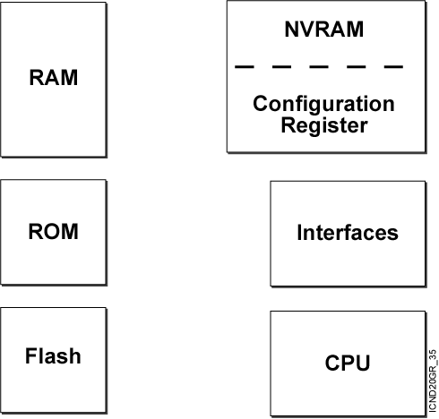
Router Internal Components
Notes:
Note:
RAM—Packet buffers, running configurations, running Cisco IOS
ROM—POST, ROM monitor, baby Cisco IOS (Rxboot)
NVRAM—Backup configurations, config register
Flash—Cisco IOS
Flash memory is nonvolatile. It behaves like a file system. It is more expensive than NVRAM. It is readable and writeable. The 2500 routers run from Flash. If it is running Cisco IOS from Flash, then the Flash is in the readable state. Use the boot system command to boot Cisco IOS from a TFTP server so the 2500 can run from RAM if you need to write or erase Flash online.

Slide 6
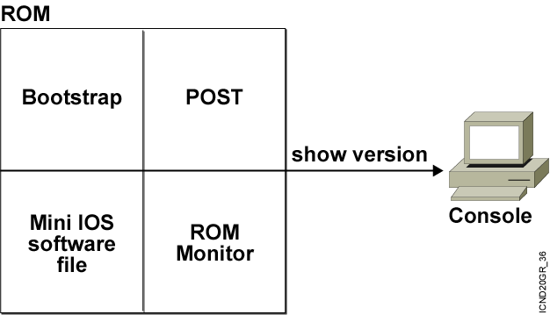
ROM Functions
Contains microcode for basic functions
Notes:
Note: Mini Cisco IOS is the Rxboot mode.
One use of the ROM monitor is for password recovery. From ROM monitor, you can set the config register to 0x2142 so the NVRAM will be ignored during startup.

Slide 7
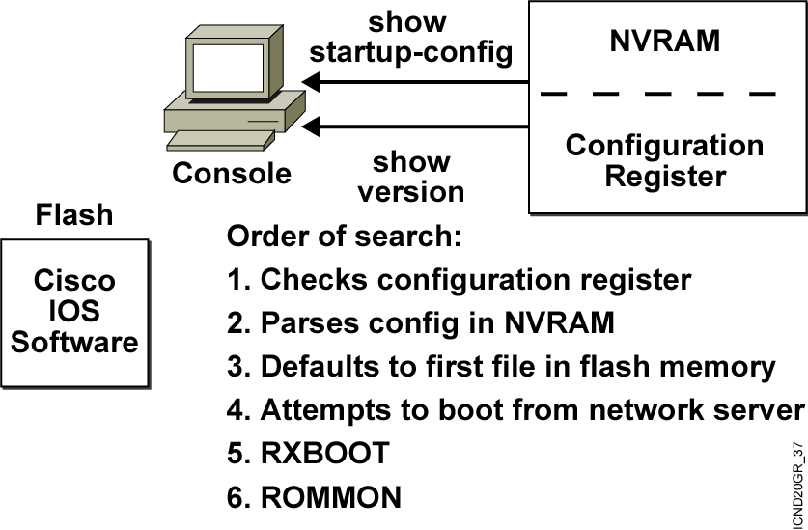
Finding the
Cisco IOS Software
Notes:
Note: There is a detailed flowchart of the router startup process on the next slide.

Slide 8
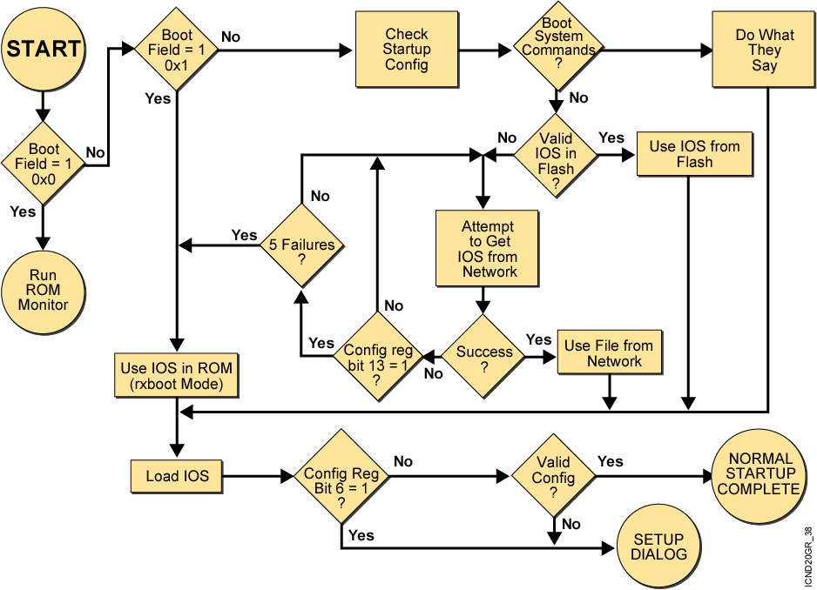
Router Startup Flowchart
Notes:
Emphasize: Go through the flow from the START state to the Normal Startup Complete state.
Note: This is a one-layer slide.
Boot field = Last four bits of the config register.
Config register is discussed in a later slide.
Refer to the Documentation CD-ROM or the Installation and Maintenance (IMCR) class for more details on the config register.

Slide 9
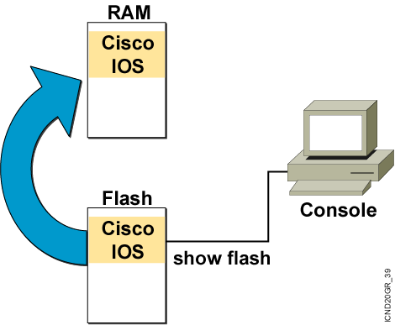
Loading the Cisco IOS Software from Flash Memory
The flash memory file is decompressed into RAM.
Notes:
Note: The 2500 series routers do not operate this way. The 2500 series routers normally run Cisco IOS from Flash. The Cisco IOS in Flash is not compressed but it is relocatable. Relocatable means the Cisco IOS image can be run from Flash or from RAM.
The 2500 can run from RAM if you use the boot system tftp command to boot the Cisco IOS image.
The Rxboot mode is also run from RAM on the 2500 routers.

Slide 10
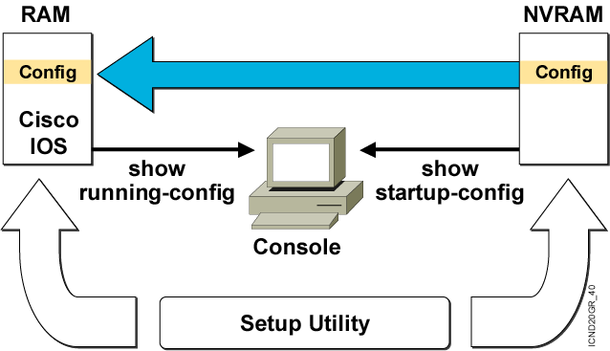
Loading the Configuration
  Load and execute the configuration from NVRAM.
  If no configuration is present in NVRAM, enter setup mode.
Notes:
Emphasize: Using the default config register value (0x2102), the router will load the config from NVRAM at startup.

Slide 11
Determining the Current Configuration Register Value
wg_ro_a#show version
Cisco Internetwork Operating System Software
IOS (tm) 2500 Software (C2500-JS-L), Version 12.0(3), RELEASE SOFTWARE (fc1)
Copyright (c) 1986-1999 by cisco Systems, Inc.
Compiled Mon 08-Feb-99 18:18 by phanguye
Image text-base: 0x03050C84, data-base: 0x00001000
ROM: System Bootstrap, Version 11.0(10c), SOFTWARE
BOOTFLASH: 3000 Bootstrap Software (IGS-BOOT-R), Version 11.0(10c), RELEASE SOFTWARE (fc1)
wg_ro_a uptime is 20 minutes
System restarted by reload
System image file is "flash:c2500-js-l_120-3.bin"
--More--
Configuration register is 0x2102
Configuration register value in show version
Notes:
Emphasize: Use the show version command to display the value of the config register setting. When you change the config register, you will see the change from the show version output:
Configuration register is 0x2102 (will be 0x2142 at next reload).
The new config register value will be used at the next reload.

Slide 12
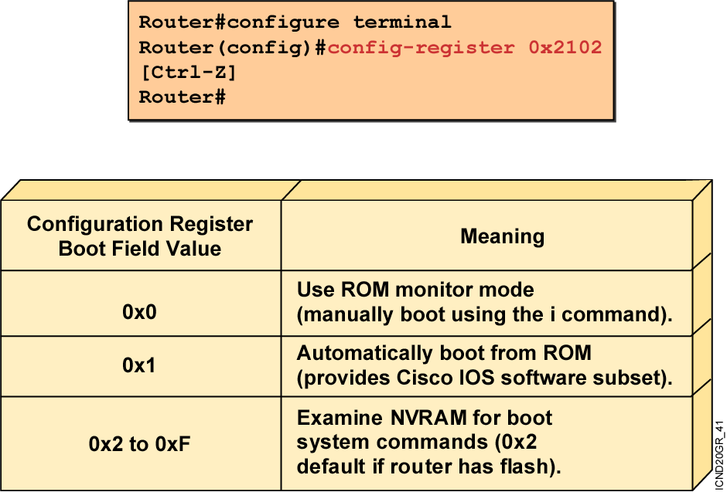
Configuration Register Values
  Configuration register bits 3, 2, 1, and 0 set boot option.
  Check the configuration register value with show version.
Notes:
Layer 4 of 4
Emphasize: Layer 4—Finishes with the third case, a boot field setting in the range of 0x2 to 0xF. The entry of a configuration register value in the 0x2 to 0xF range is significant. When the router attempts to boot from the net (Netboot), the bootstrap program generates a Cisco IOS filename based on the value of the boot field. For example, with the setting 0x2, the default Cisco IOS filename generated will be cisco2-xxxx, where xxxx refers to a processor name (for example, 2500). Again, refer students to the IMCR course for details.
You use the config-register command to change the value.
Notice that the bottom lines of the show version output indicates what value the config register will be on the next reload.

Slide 13
show version Command
Router#show version
Cisco Internetwork Operating System Software
IOS (tm) C2600 Software (C2600-JS-M), Version 12.0(7a), RELEASE SOFTWARE (fc1)
Copyright (c) 1986-2002 by cisco Systems, Inc.
Compiled Tue 05-Feb-02 01:48 by pwade
Image text-base: 0x80008088, data-base: 0x80B0404C
ROM: System Bootstrap, Version 11.3(2)XA4, RELEASE SOFTWARE (fc1)
Router uptime is 1 minute
System restarted by reload
System image file is "flash:c2600-js-mz.120-7a.bin"
cisco 2610 (MPC860) processor (revision 0x300) with 53248K/12288K bytes of memory.
Processor board ID JAD06090BMD (2719249260)
M860 processor: part number 0, mask 49
Bridging software.
X.25 software, Version 3.0.0.
SuperLAT software (copyright 1990 by Meridian Technology Corp).
TN3270 Emulation software.
Basic Rate ISDN software, Version 1.1.
1 Ethernet/IEEE 802.3 interface(s)
2 Serial(sync/async) network interface(s)
1 ISDN Basic Rate interface(s)
32K bytes of non-volatile configuration memory.
16384K bytes of processor board System flash (Read/Write)
Configuration register is 0x2102
Notes:
Note: The current state of the Flash memory is in read-only mode. It is running Cisco IOS from Flash.
This router has a total of 16 MB of Flash memory. The Flash contains one Cisco IOS image and there is 6.69 MB of available space left in Flash.

Slide 14
show flash Command
wg_ro_a#show flash
System flash directory:
File Length Name/status
1 10084696 c2500-js-l_120-3.bin
[10084760 bytes used, 6692456 available, 16777216 total]
16384K bytes of processor board System flash (Read ONLY)
Notes:
Note: The current state of the Flash memory is in read-only mode. It is running Cisco IOS from Flash.
This router has a total of 16 MB of Flash memory. The Flash contains one Cisco IOS image and there is 6.69 MB of available space left in Flash.

Slide 15
show running-config and show startup-config Commands
In RAM
In NVRAM
wg_ro_c#show running-config
Building configuration...
Current configuration:
!
version 12.0
!
-- More --
wg_ro_c#show startup-config
Using 1359 out of 32762 bytes
!
version 12.0
!
-- More --
  Displays the current and saved configuration
Notes:
Purpose: This slide is a repeated slide from Chapter 4, “Operating and Configuring a Cisco IOS Device.”

Slide 16
Summary
  When a router boots, it performs tests, finds and loads software, finds and loads configurations, and finally runs the software.
  The major internal components of a router include RAM, ROM, flash memory, NVRAM, and the configuration register.
  When a router boots, it searches for the IOS software image in a specific sequence: location specified in the configuration register, flash memory, a TFTP server, and ROM.
  The configuration register includes information specifying where to locate the Cisco IOS software image. You can examine the register with a show command and change the register value with the config-register global configuration command.
Notes:
Purpose: This slide discuss the initial configurations on the routers and switches.
Note: There is no setup mode on the Catalyst 1900 switch.

Slide 17


